Slide 1

Metals plasticity
Irene J. Beyerlein,
University of California, Santa Barbara, CA

Slide 2
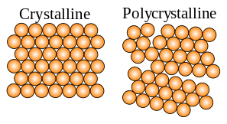
A metal
A crystalline solid that is stretchable!
Plasticity is permanent deformation; in a metal, plasticity is due to the motion of dislocations
Dislocations are linear crystalline defects; disruptions in perfect crystalline order; linear because unconfined in one dimension
Dislocations move easily in a metal
Regular atomic arrangement
Deformation to relieve stress occurs by dislocation motion on particular crystalline planes and directions

Slide 3
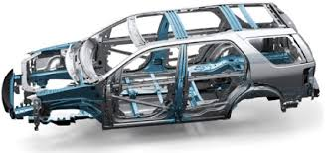
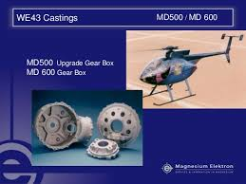

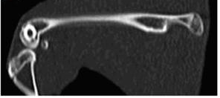
Why metals?
Forefront and sometimes only choice in industrial application, for critical load bearing parts
Modern aircraft, automobiles, trains, ships and endless number of vehicles (recreational, military); buildings; implantable devices;
Modern focus: Developing new materials, new processes to make them and testing new theories and models to understand them
Automotive
Aircraft
Aerospace
Biomedical

Slide 4
Metals and plasticity
General outline
Phenomenology of plasticity
Dislocation Geometry
Dislocation stress, strain, and energy
Multiscale understanding
Dislocation motion and interactions
Crystal plasticity theory
Special focus topics
Misfits at an interface
Partial dislocations and cross slip
Nucleation at interfaces
Size effects in nanomaterials

Slide 5
phenomenology

Slide 6
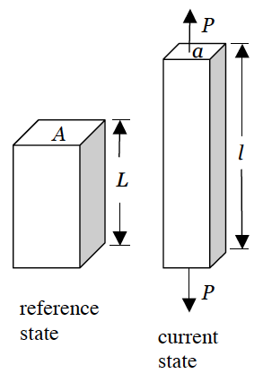
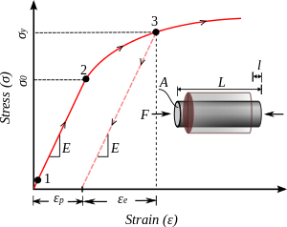
A simple test
More load
Light load

Slide 7
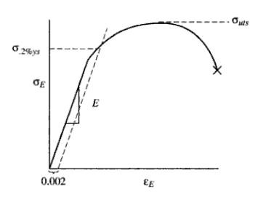
3 tensile test measures
Pieces of data from tensile tests:
yield strength,
ultimate tensile strength,
ductility
Yield
Strength
Ultimate strength
Strain to failure
Ductility
Toughness (Area)

Slide 8
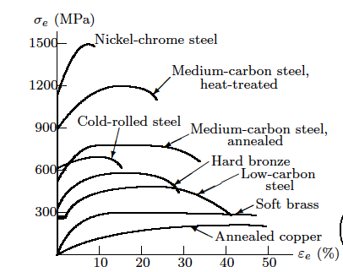
Different metals
Desired property: High Yield, high UTS, high ductility
Not all steels are alike
Cu and alloys of Cu are relatively weaker

Slide 9
Orowan on tensile testing
The tensile test [is] very easily and quickly performed but it is not possible to do much with its results, because one does not know what they really mean. They are the outcome of a number of very complicated physical processes. The extension of a piece of metal [is] in a sense more complicated than the working of a pocket watch and to hope to derive information about its mechanism from two or three data derived from measurement during the tensile test [is] perhaps as optimistic as would be an attempt to learn about the working of a pocket watch by determining its compressive strength.
E. Orowan [1944], physicist and metallurgist

Slide 10
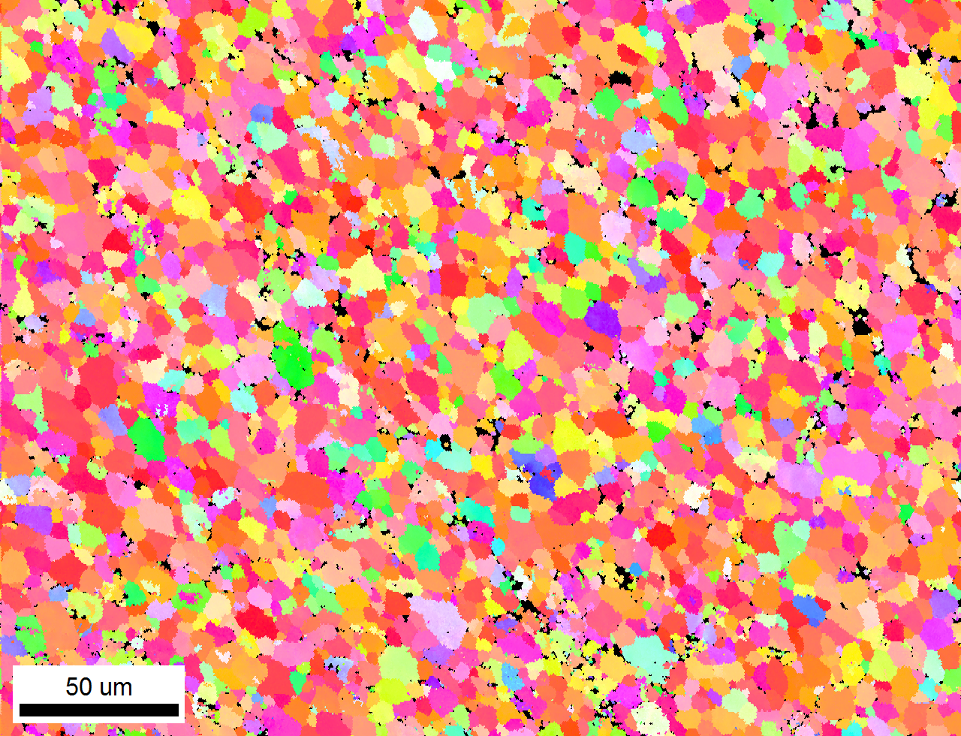
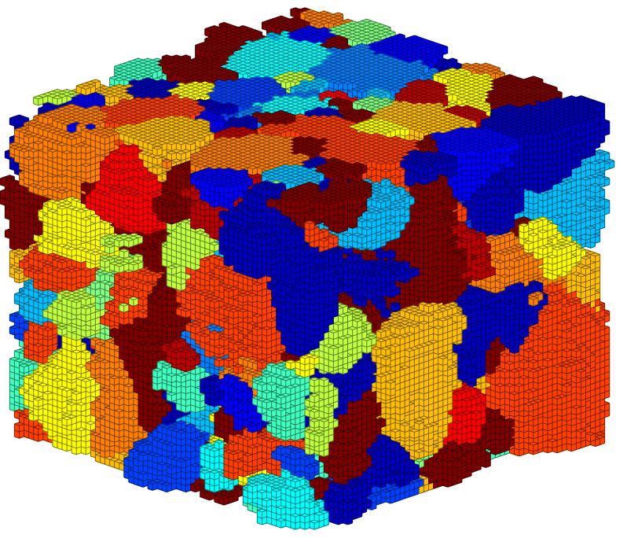
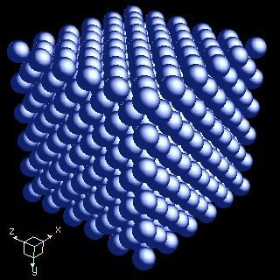
Polycrystalline metal
2D polycrystalline slice
Orientation Map
Grains and grain boundaries
Each grain has ordered structure

Slide 11
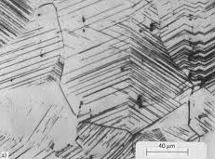
History of analysis
Polycrystalline metal
Unwin (1894) produced a comparison of plastic load versus deformation curves for copper and a carbon-steel exhibiting different yield points
Mechanisms: In earlier reports, Rosenhain (1899) and Ewing and Rosenhain (1900) had “applied the name ‘slip bands’ to lines developed on metal surfaces by plastic strain …” based on optical observations obtained on a variety of deformed metals.
Antolovich, Phil Trans Roy Soc 2015

Slide 12
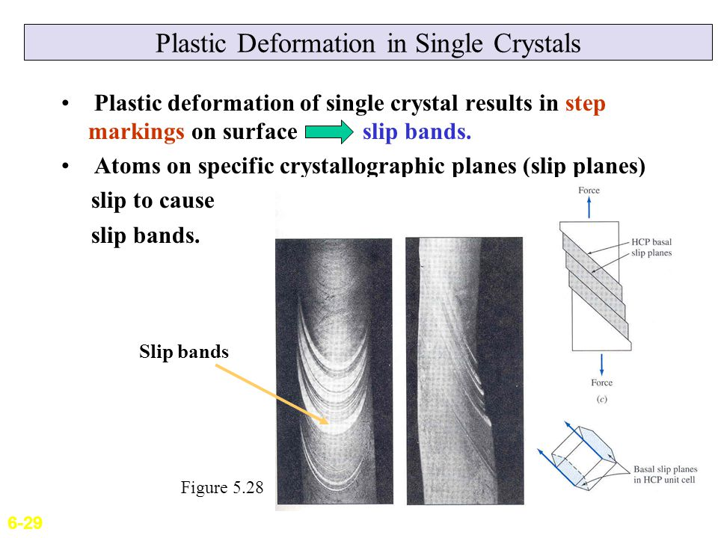
Single crystal
20th century single crystals could be produced
G. I. Taylor and Elam (1926) tests on crystals in tension or compression for reference properties
Some common characteristics
1) Yield takes place in definite crystallographic planes
2) Sheets of crystals slip over one another
3) Deformation was highly inhomogeneous localized in slip bands between the sheets
4) Realized that deformation occurs in integral multiples of the lattice spacing since the crystal structure of the material did not change
Slip bands

Slide 13
Slip in a single crystal
D. Hurtado, 2010, PhD thesis, Caltech

Slide 14
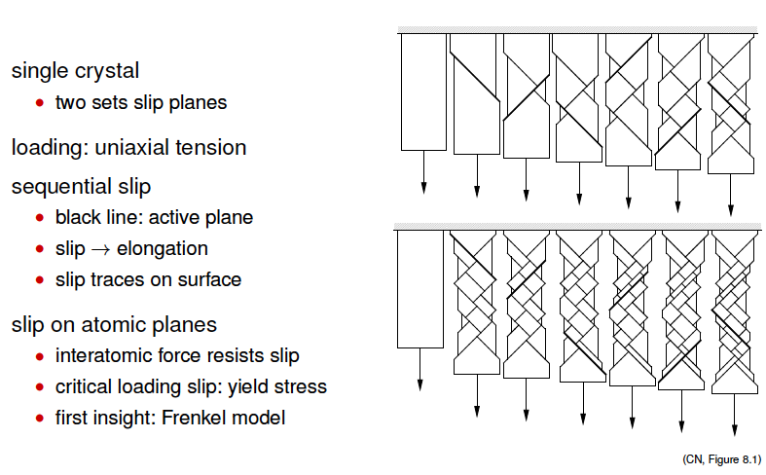
Plasticity of a single crystal
Crystal of arbitrary orientation or loading will slip on many planes of different location and orientation
Summary:
Deformation is not uniform and occur in localized regions in the crystal
Slip along multiple, independently oriented crystallographic planes
Slip bands form along these planes and separate undeformed regions
With more deformation, more localized regions and larger surface steps
These bands are permitting large deformation with little stress (compared to elasticity)

Slide 15
dislocations

Slide 16
Theory started in 1905
V. Volterra
Dislocation theory
Hollow elastic tube
Not yet an explanation for plasticity
These were cuts; the term “dislocations” came nearly 30 years later
Straight dislocations, no atoms, no crystallinity
These later were associated with dislocations
Heroes of Dislocation Science

Slide 17
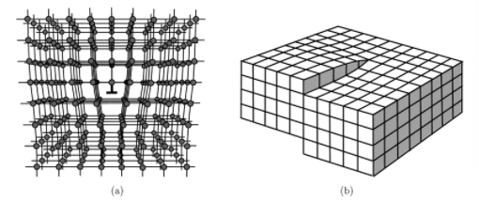
Dislocations
Taylor, Orowan, Polyani, 1934
G.I. Taylor
Coined term “dislocation”
These three described atomic core
Connected theory of Volterra to explain plasticity
Later known to be what we call an “edge” dislocation
Explained by metals yield at far below theoretical yield strength
Edge dislocation:
Line of defect directed out of the page
Displacement caused by it is normal to the line

Slide 18
The ease of motion
Edge dislocation
No lattice reorientation
Burgers vector
R. LeSar; Computational Materials Science
This step is the amount of atomic displacements around the dislocation
(CN, Figure 8.3)

Slide 19
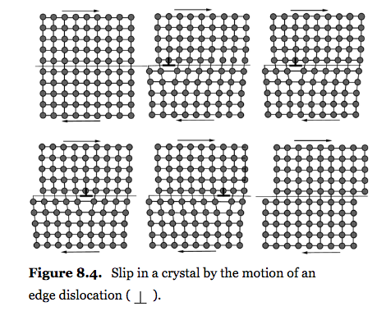
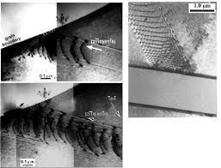
Dislocation motion
When a dislocation moves, it completes a lattice translation vector
Dislocation arrays and pile ups

Slide 20
Collective motion
Visible plasticity results from numerous dislocations
Displacement caused by one dislocation
~0.5 nm to 1 nm
One micron step,
~500 to 1000 dislocations on one plane

Slide 21
Recap
Elasticity: little to no dislocation motion
Distortion of atomic bonds
No change in atomic neighbors
Distortion is recovered upon unloading
Plasticity: numerous dislocations glide, shift the lattice, atomic neighbors change,
result in permanent deformation, plastic distortion remains after unloading

Slide 22
Dislocation geometry

Slide 23
References
Slides, Lecture Material
Bob Svendsen, Jaber Mianroodi, RWTH Aachen University, Germany
Carlos Tomé, Ricardo Lebensohn, Los Alamos National Laboratory

Slide 24
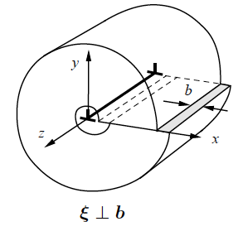
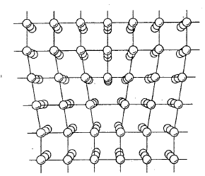
Edge dislocation core
Taylor, Orowan, Polyani, 1934
Upper part of crystal contains an extra half plane
Bottom part does not contain it
The line of intersection between the plane of extra atoms and the glide plane is the dislocation line
The Burgers vector characterizes atomic displacements around this line
The shift displaces the top half relative to the bottom half in a direction normal to the line
Line divides slip and un-slipped region

Slide 25
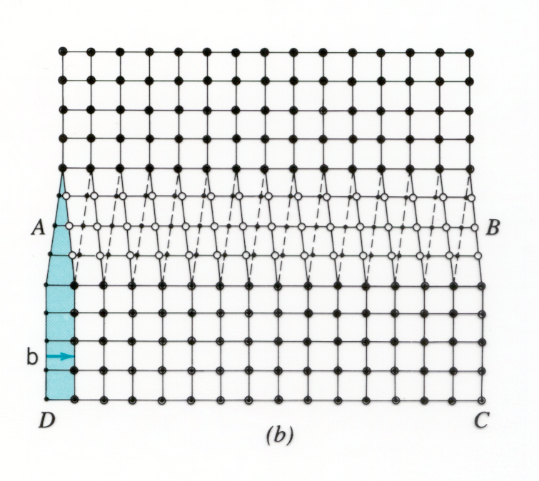
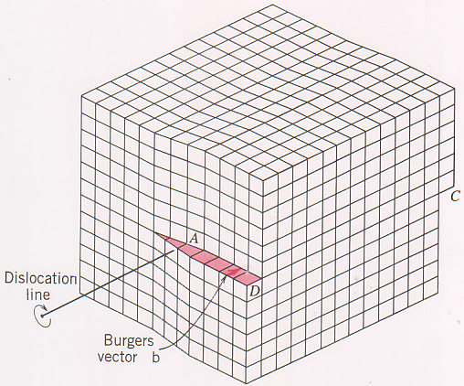
Screw dislocation
J. Burgers 1939
Burgers vector named after J. Burgers
Invented screw dislocation (in contrast to edge)
Dislocations are not all edge dislocations
He gave dislocations “character”
Top view
3D view
Screw dislocation:
Line divides slipped and un-slipped region
Displacement caused by screw dislocation lies parallel to its line
Above: The line and Burgers vector are directed normal to the plane
Right: along AB

Slide 26
Dislocation Burgers vector
J. Burgers 1939
Draw contour in non-defected “perfect” material around the dislocation line
First draw it without the dislocation
Then draw the same contour around the dislocation
Example is for edge but Burgers vector is same everywhere on the line

Slide 27
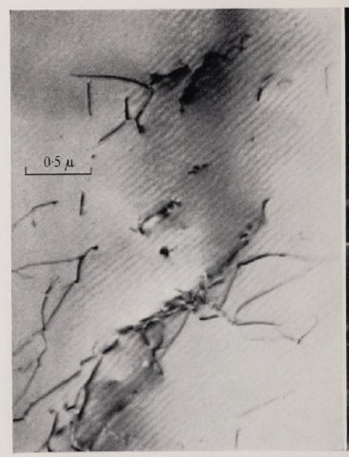
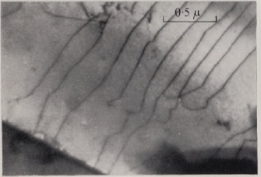
Discovery of a dislocation
Dislocations in precipitate of stainless steel -Wikityke
First TEM image of Al
1956
P. Hirsch
Al
Ni
Hirsch et al. 1960

Slide 28
Two dislocation characteristics
Dislocations are linear defects,
Linear: One dimension is unconfined
Dislocations can be infinitely long
It can be anything
Burgers vector, characterizes the atomic displacements around a dislocation; does not vary along the line; rigidly defined by crystal
Two extremes

Slide 29
Dislocation sign
Dislocations have sign; direction of motion, annihilation, interaction
Edge, whether extra half plane is above or below; screw, whether slip sense is same or opposite to line sense
Need to define positive line sense

Slide 30
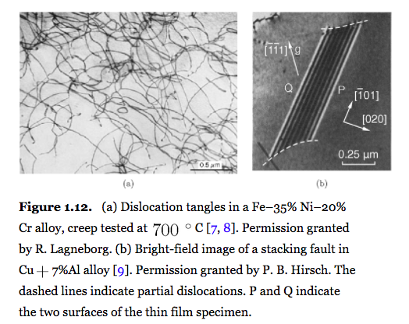
Actual dislocations are curvy
CN, Fig. 1.12
Cr steel
Hirsch

Slide 31
Actual dislocations are mixed
The dislocation Burgers vector is fixed but the line can vary
The dislocation moves normal to the line and shear occurs in the direction of the Burgers vector

Slide 32
Multiscale understanding of plasticity

Slide 33
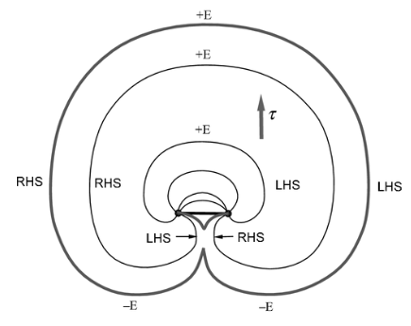
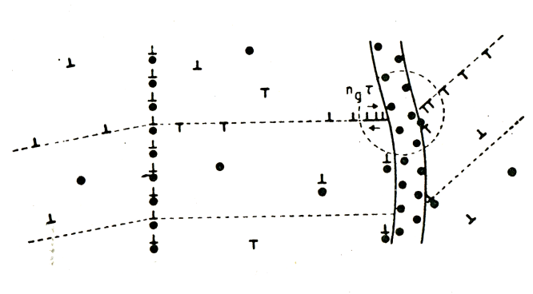
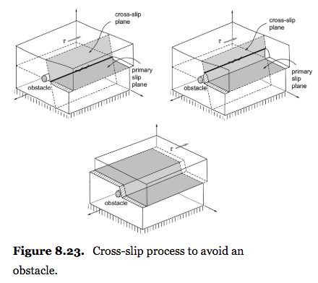
Dislocation
Plastic deformation results from the motion of dislocations
Dislocations are nucleated, stored, and annihilated during mechanical straining
Annihilation of 2 dislocations
Frank-Read Source for dislocation loops
Storage inside crystal and at boundaries
Dislocation overcoming an obstacle by cross slip

Slide 34
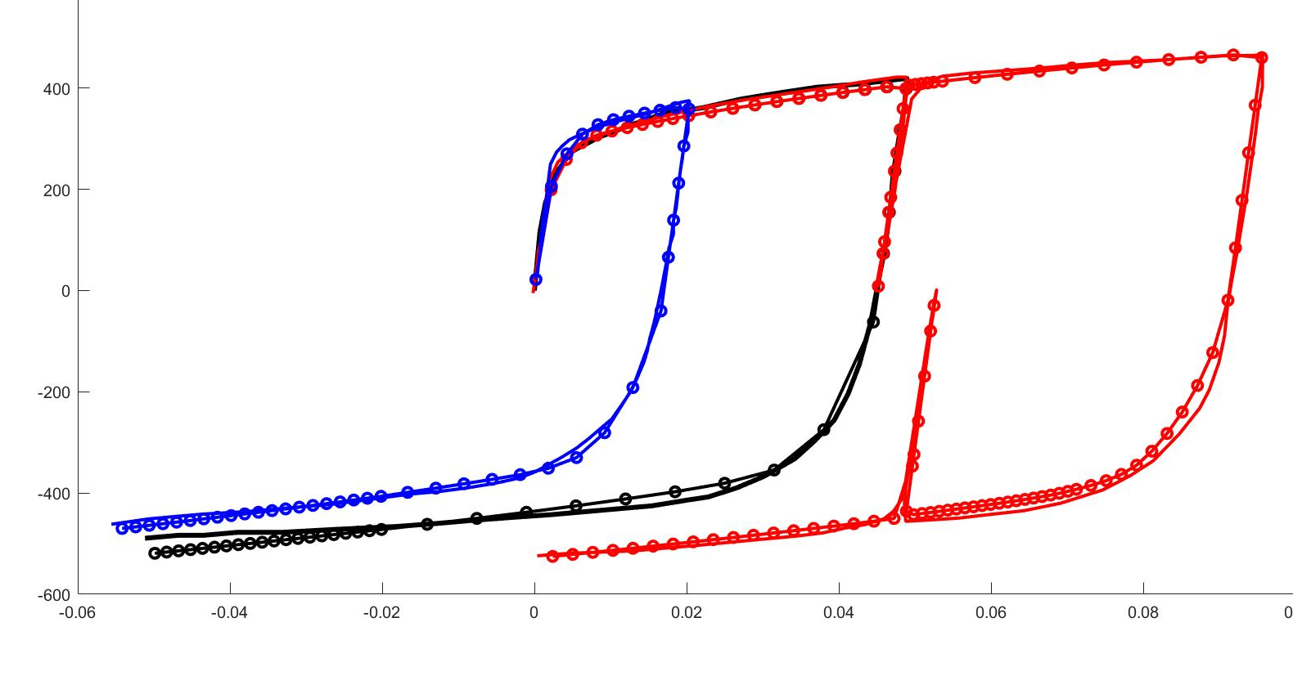
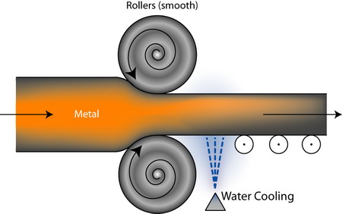

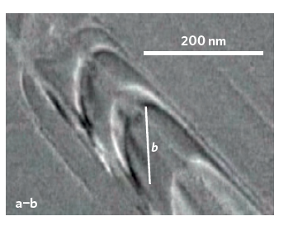
Multiscale plasticity
Homogeneous phase
Polycrystals
Single crystals
Dislocation networks
Dislocation arrays
Dislocation core

Slide 35
Multiscale defects
Other defects in the metal play a role as obstacles to dislocation motion or in the annihilation, storage, and nucleation of dislocations
Courtesy of Drs. R. Svendsen, D. Raabe

Slide 36
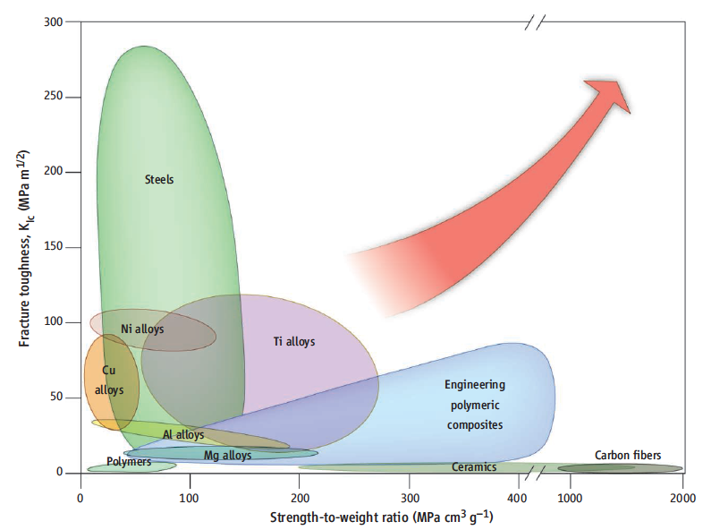
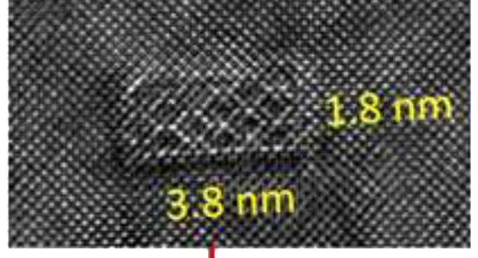
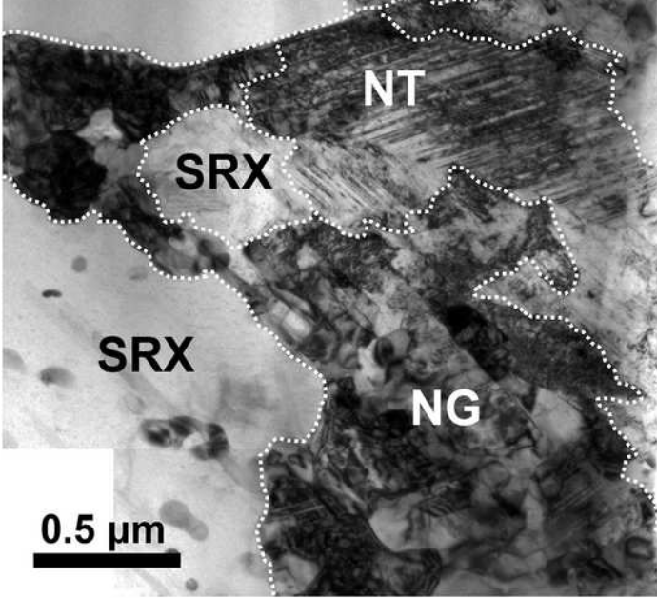
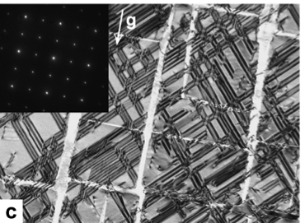
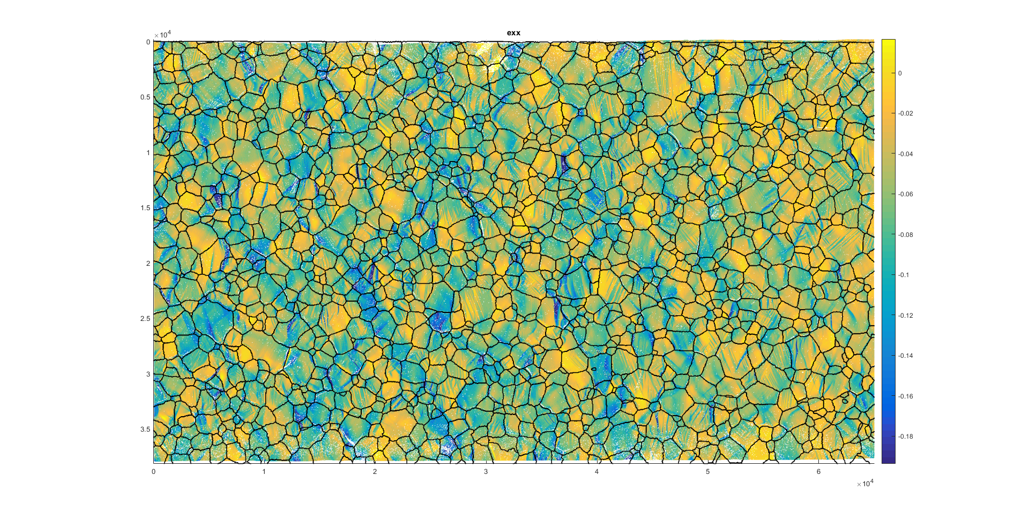
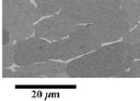
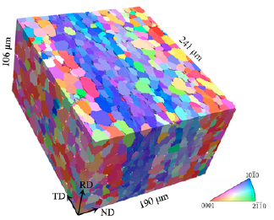
Multiscale modification
Corrosion resistant Mg
“Future of Metals”
Ke Lu, Science, 2010
BETTER
Nanotwinning materials
Superalloys
Zheng et al., 2018
Formable Mg alloys
Ti alloys
Daly, Chen 2018
Echlin et al., 2016
Titus et al. AM 2015

Slide 37
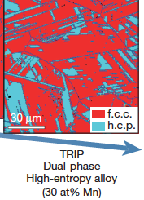
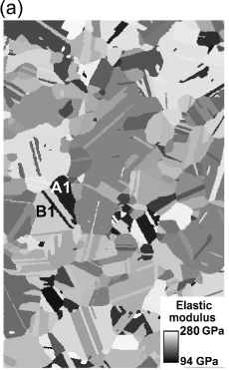
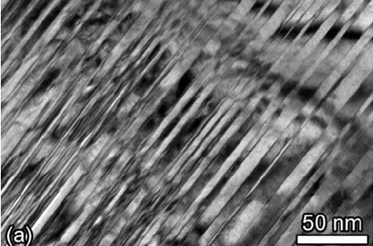
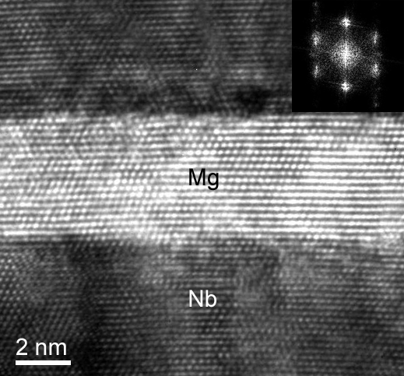
Processing-dependence
Additive manufactured
ECA-Extrusion
Alloying and heat treatments
Ni-based superalloy
Mg
Nb
Deposited nanotwinned copper
Two-phase bimetallic
Deposited nanotwinned copper

Slide 38
Dislocation motion

Slide 39

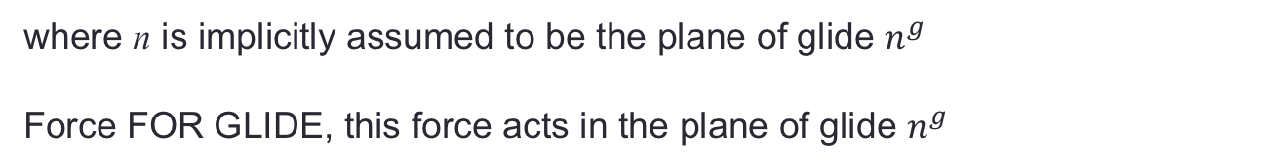
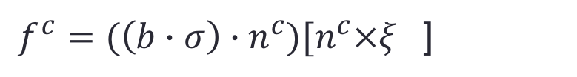
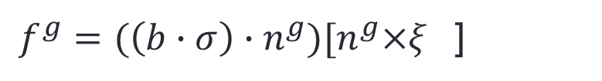


To move a dislocation
Resolved shear stress
$${T=σ}_{ij}$$
Consider an applied stress T to the crystal:
Resolved shear stress FOR SLIP
${τ=σ}_{ij}b_{i}$ $n_{j}=(\left(b∙σ\right)∙n^{g})$
where n is implicitly assumed to be the plane of glide $n^{g}$
Force FOR GLIDE, this force acts in the plane of glide $n^{g}$
${f^{g}=(\left(b∙σ\right)∙n^{g})[n^{g}×ξ}_{}$]
Force for climb, this force acts in the plane of climb $n^{c}$
The total force for motion of a dislocation is the motion for glide and climb
${f^{c}=(\left(b∙σ\right)∙n^{c})[n^{c}×ξ}_{}$]
The Peach-Koehler (PK) force gives the total force vector acting on an arbitrary dislocation with Burgers vector b and given stress σ.
$${f=\left(b∙σ\right)×ξ}_{}$$

Slide 40
Dislocation interaction

Slide 41
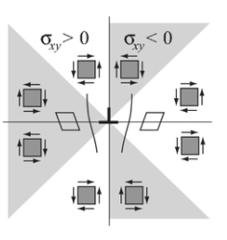
Dislocation interaction

Slide 42
Critical stress for passing
Far field stress T_{ext}
Force to hold in position
Force to hold in position

Slide 43
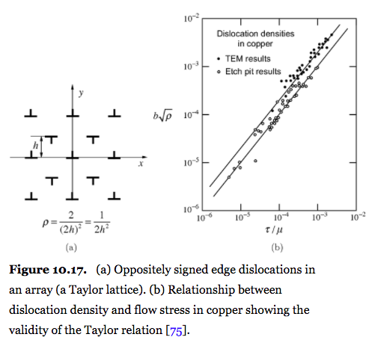


Taylor hardening
Critical passing stress: values of x where τ achieve maximum
$${τ=μb/8π\left(1−ν\right)h}_{}$$
Suppose under an applied strain a density of dislocations ρ evolves
Interactions with other dislocations hinders dislocation glide
Average spacing for density ρ is h
Use critical passing stress to approximate the stress needed for a dislocation to glide
The following hardening relationship is called Taylor hardening
Random array of positive and negative dislocations
$${τ=αμb\sqrt{ρ}}_{}$$

Slide 44
Taylor hardening: Cu
Mecking and Kocks, 1981

Slide 45
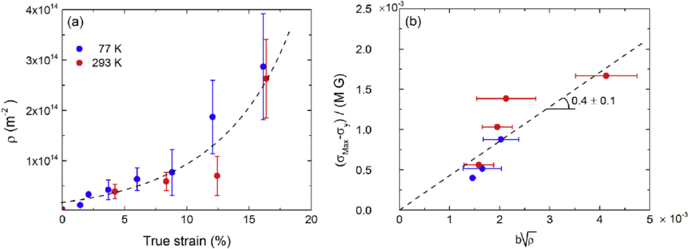
Taylor hardening: MPE
LaPlanche et al. Acta Mater. 2016

Slide 46
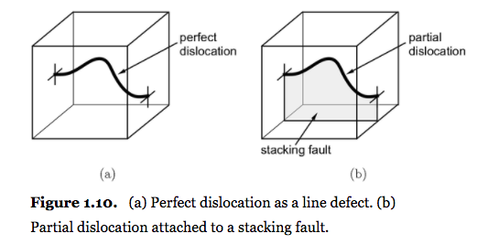
Special focus topic
PARTIAL DISLOCATIONS AND CROSS SLIP
2-D defect: stacking fault

Slide 47
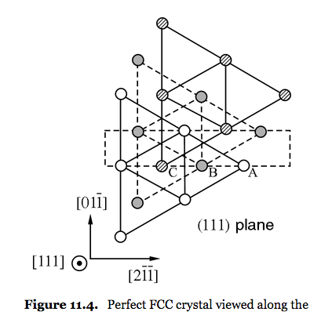
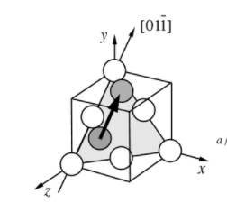
Special focus topic
Repeat translation
2
1
1
Face center cubic (FCC)
Stainless steel, Al, Cu, Ni

Slide 48

Special focus topic
Stacking fault is a disruption of perfect stacking
Fault created by a partial is an intrinsic stacking fault
A missing atomic layer
Excess energy due to an intrinsic stacking fault
2-D defect: stacking fault
Perfect
Perfect
Glide of this partial creates the fault
Glide of this second partial corrects the fault

Slide 49
Stacking fault width
With this configuration, let’s consider the force balance between the interaction between the two dislocations and the creation of the stacking fault width in-between
FCC LATTICE
FROM ONE SCREW TO TWO MIXED

Slide 50
Force balance

Slide 51
Force balance

Slide 52
Force balance

Slide 53
Stacking fault width
Force balance between the interaction between the two dislocations and the stacking fault width in-between
The lower the stacking fault energy, the wider the stress-free equilibrium stacking fault width

Slide 54

An example
Excess energy due to an intrinsic stacking fault
4 nm edge
1.2 nm screw
Gold, 32 mJ/m²
Beyerlein et al. Ann Rev Mater Res 2014

Slide 55


Special focus topic
Stacking faults in a copper-aluminum alloy
Stacking faults in a semiconductor material
Stacking faults in a Cu-Ge alloy
See CN, Chapter 8

Slide 56
Cross slip
Cross slip is a mechanism screw dislocations can use to maneuver around obstacles
CN, Fig. 8.24
Dislocations must constrict in order to cross slip
The more extended dislocation, the harder it becomes to cross slip
Activation energy ΔG to constrict the extended dislocation scales with x_{eq}.

Slide 57
Dislocations and obstacles

Slide 58
Hinder dislocation motion
Important situation to consider is the bow out of a dislocation between two pinning points separated by L
JAEA, research group for nuclear materials modeling

Slide 59

Dislocation-obstacle interaction
Line tension approximation--tension is constant wrt character along length
Tension resists bending and straightens curved dislocation
Consider the force balance in the vertical direction

Slide 60


Obstacle strengthening
Consider an array of nanoparticles
Dislocation motion is hindered. What is the critical stress to bypass the obstacles?
Maximum stress corresponds to the minimum radius of curvature
Breakaway stress
Rough approximation T ~ W
ρ ~ (L-d)/2
$τ_{c}= \frac{2Aμb}{(L−d)}$ln($\frac{α(L−d)}{r0}$)
The smaller the spacing; the higher the particle density, the harder glide becomes

Slide 61
Frank-Read Source
Critical bow-out configuration

Slide 62
Bow out
Line energy depends on screw/edge character
Dislocation bow out configuration depends on character of original dislocation

Slide 63


Pile up
Pile ups in a Cu-Al alloy

Slide 64


Grain size effect
“Smaller is stronger”
Grain boundaries hinder dislocation motion
Smaller grain sizes mean higher grain boundary surface to grain volume ratios
Question that remains is why the grain size effect in so many different materials follows Hall-Petch scaling law
Data:
Hall, 1951, Yield point in steel
Petch, 1953, Cleavage in Iron
Grain size
Copper
Kok and Beaudoin, 2003
Armstrong, MSME, 2015

Slide 65

Occurs in many types
BCC
HCP
FCC
“Smaller is stronger”
Armstrong, MSME, 2015

Slide 66
Crystal Plasticity

Slide 67



Slip in single crystal
Slip results from the glide of many dislocations
No longer important to consider individual, discrete dislocation
${τ=σ}_{ij}b_{i}$ $n_{j}$
$$b∙σ∙n=\text{T}:b⨂n$$
The Schmid tensor
m = $b⨂n$
Sometimes
sym(m) = ½$\left(b_{i}n_{j}+b_{j}n_{i}\right)$

Slide 68




Schmid factor
${\text{L}}^{α}={{\dot{γ}}^{α}b}^{α}{⨂n}^{α}$= ${\text{D}}^{α}$+ ${\text{W}}^{α}$
$L_{ij}^{p}={\dot{γ}}^{α}b_{i}n_{j}$=$D_{ij}^{p}$+ $W_{ij}^{p}$
Plastic strain rate
$D_{ij}^{p}$=½$\left(b_{i}n_{j}+b_{j}n_{i}\right)$ ${\dot{γ}}^{α}$
Plastic spin rate
$W_{ij}^{p}$=½$\left(b_{i}n_{j}−b_{j}n_{i}\right)$ ${\dot{γ}}^{α}$

Slide 69


Plastic spin
Crystals deform by shear, propagating dislocations along close-packed atomic directions
Crystallographic shear induces crystal reorientation.
As a consequence, there is:
texture evolution during plastic deformation.
anisotropy evolution during plastic deformation
a need to capture this effect with crystal plasticity models!
$W_{ij}^{p}$=½$\left(b_{i}n_{j}−b_{j}n_{i}\right)$ ${\dot{γ}}^{α}$
$ω_{ij}^{p}$=½$\left(b_{i}n_{j}−b_{j}n_{i}\right)$ $γ^{α}$
Specimen rotation = 0
Lattice rotation
then must be −$ω_{ij}^{p}$

Slide 70
Single crystal in a polycrystal
Co-deformation, crystals deforming by plasticity must reorient
No co-deforming

Slide 71
Origin of texture evolution
n
n
crystallographic
inclusion
inside stressed
medium
put back inside cavity
separate
inclusion
from medium
rotate
to fit inside cavity
shear the inclusion

Slide 72

One active slip system
Deformation gradient by elasticity and plasticity: Consider the case of only one slip system active
(m,s) = m is slip plane normal and s is the slip direction
Elastic deformation
No crystallographic slip
Reoriented lattice
Rate form: lattice spin
m,s are aligned with a grid
The grid is used to guide the eye
No elastic deformation
No reorientation
Shear due to slip
Shape has a “rotation”
Rate form: plastic spin
R. J. Asaro, 1983, J. Appl. Mech.

